Slide 1
Introduction To Azure Load Balancing.
Tashik Moin MLSA, Microsoft. Tashik.Moin@StudentAmbassadors.Com
References Microsoft Ignite Microsoft Learn MSDN
Notes:
Good morning! I'm [ YOUR NAME ] and I'm absolutely thrilled to join you in [ CITY YOU ARE IN ].
Azure provides compute, storage and networking for the cloud
If you're new to Azure, or the cloud, it can be intimidating
This session will cover the essential concepts you'll need to get off and running with Azure networking

Slide 2
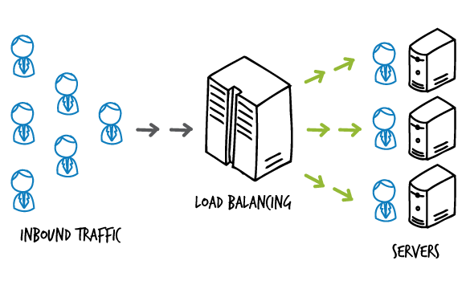

Slide 8
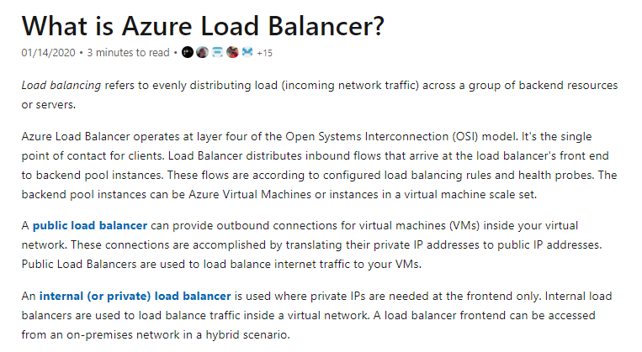

Slide 9
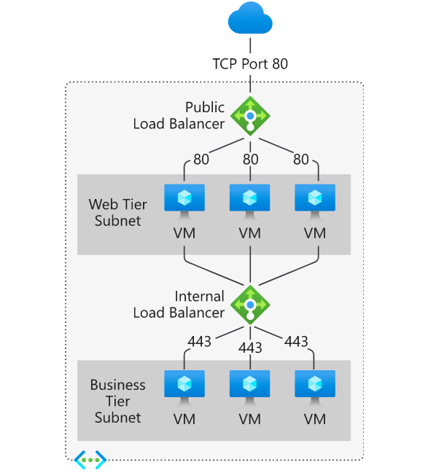
HTTP(80) port works on application layer whereas the HTTPS(443) port works on transport layer of the OSI & TCP/IP Models.

Slide 10
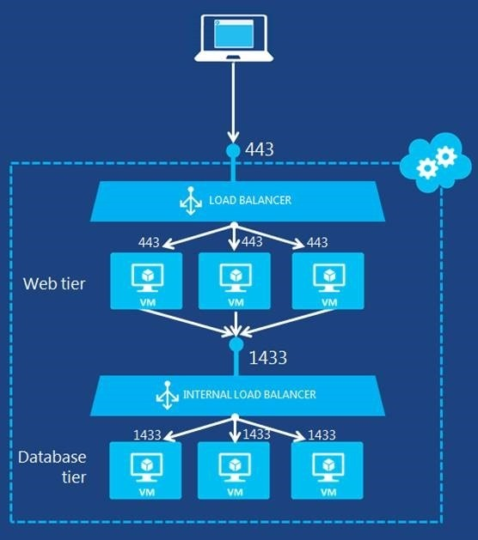
Client systems use TCP 1433 to connect to the database engine; SQL Server Management Studio (SSMS) uses the port to manage instances of SQL Server across the network. You can reconfigure SQL Server to listen on a different port, but 1433 is by far the most common implementation.

Slide 11
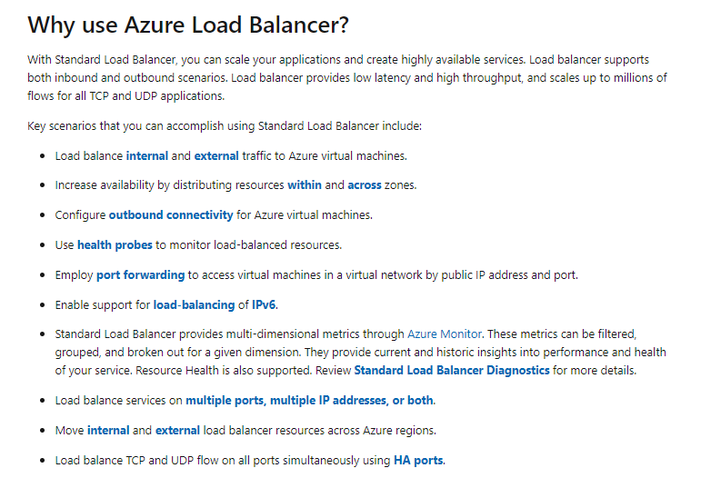

Slide 12
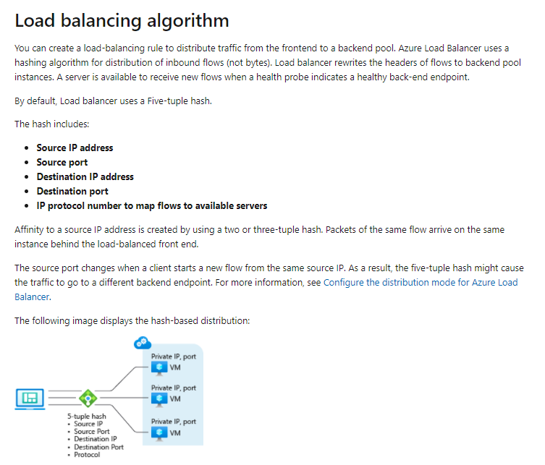

Slide 13
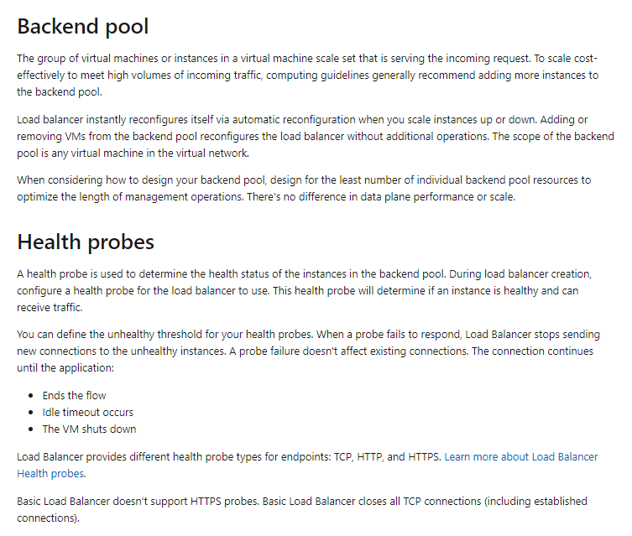

Slide 14
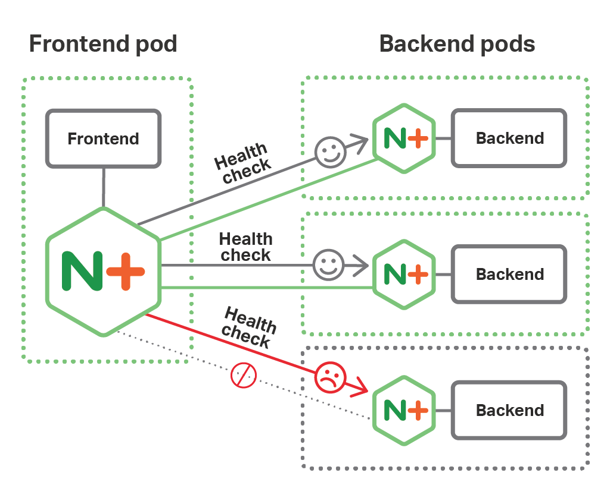

Slide 15
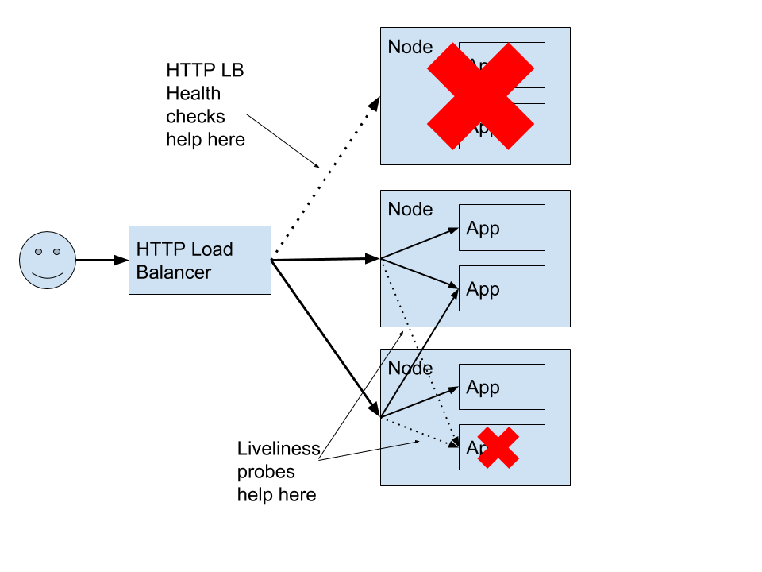

Slide 16
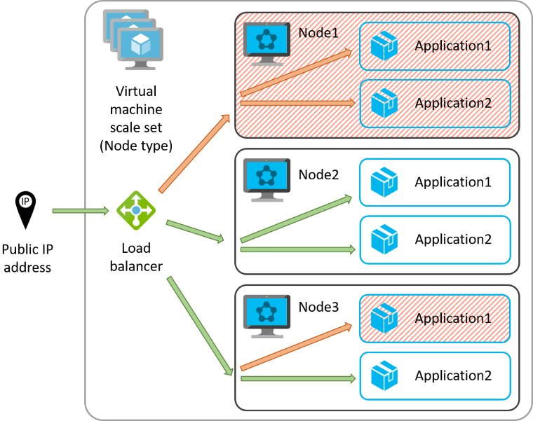

Slide 18
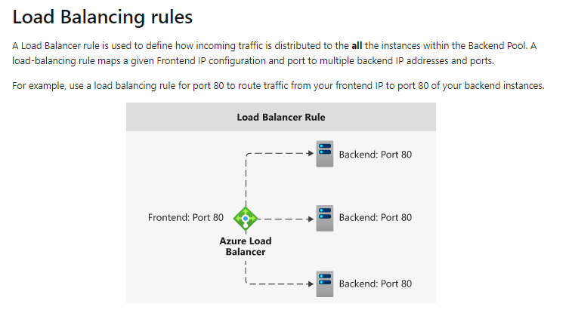

Slide 19
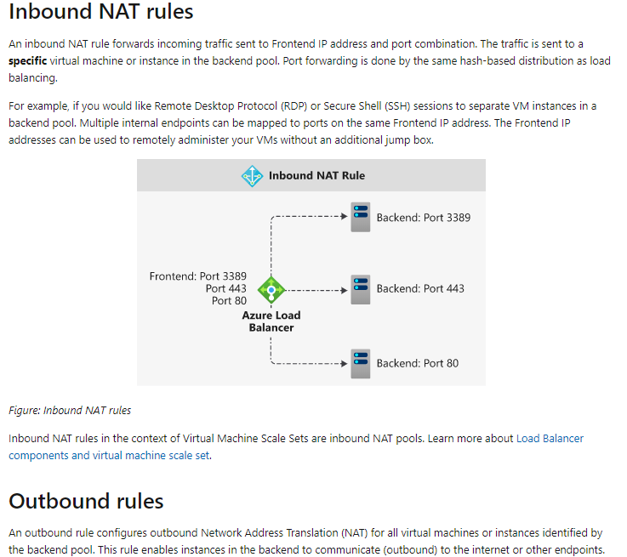

Slide 20
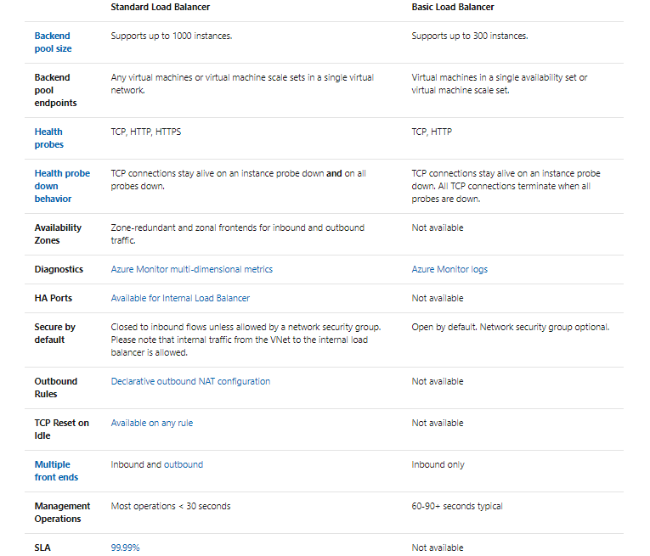

Slide 21
Creation Of A Internal Load Balancer

Slide 22
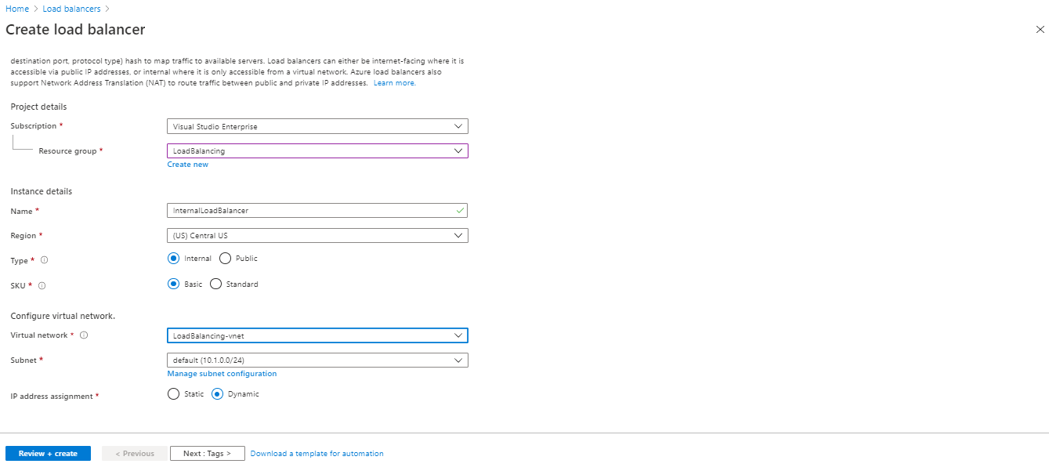

Slide 23
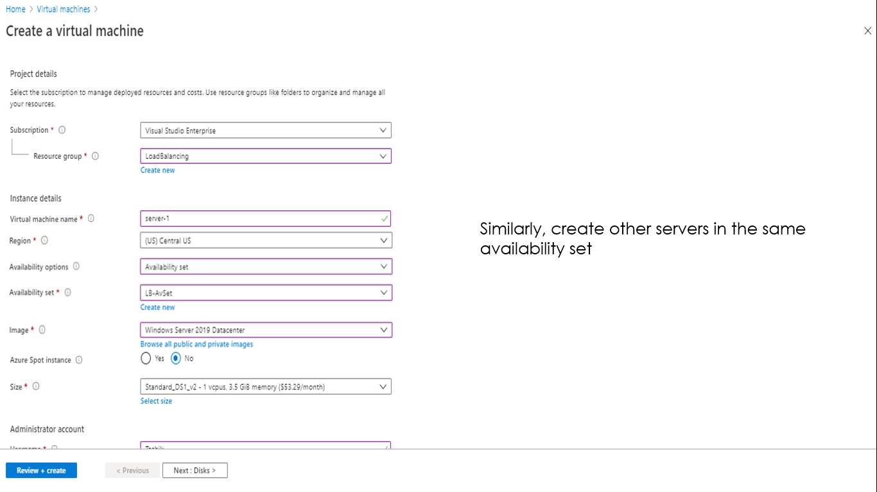

Slide 24
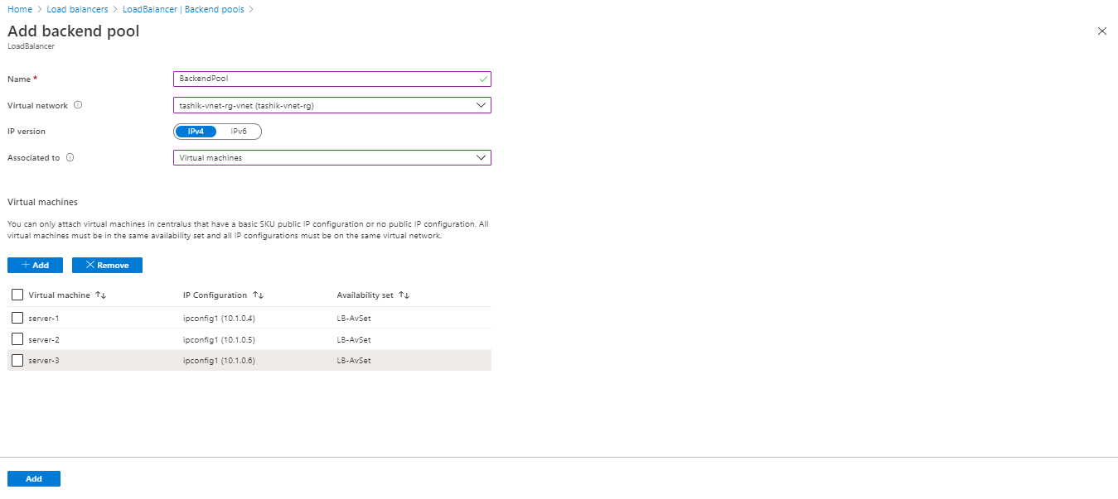

Slide 25
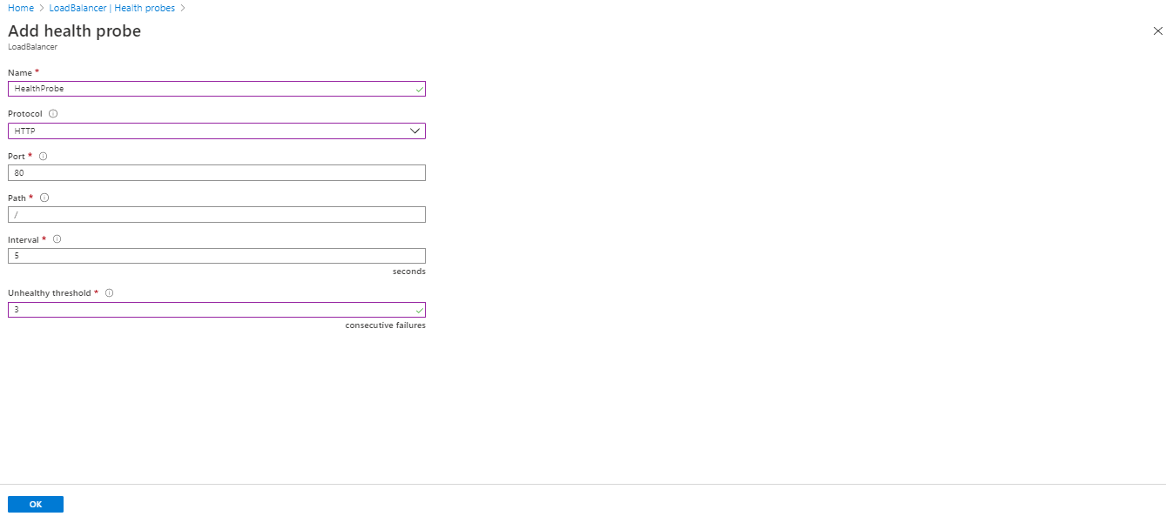

Slide 26
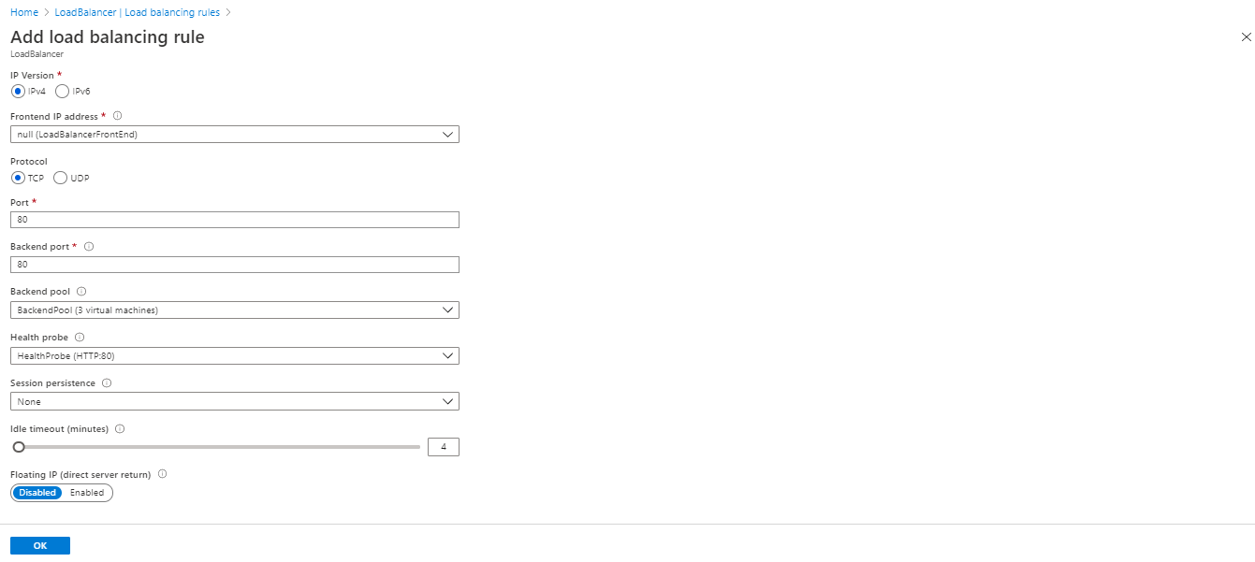

Slide 27
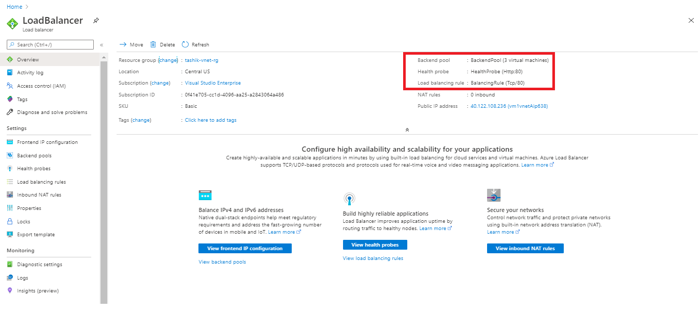

Slide 28
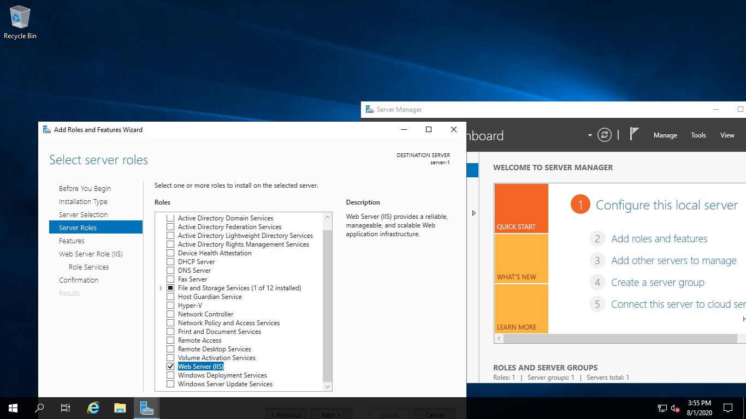

Slide 29
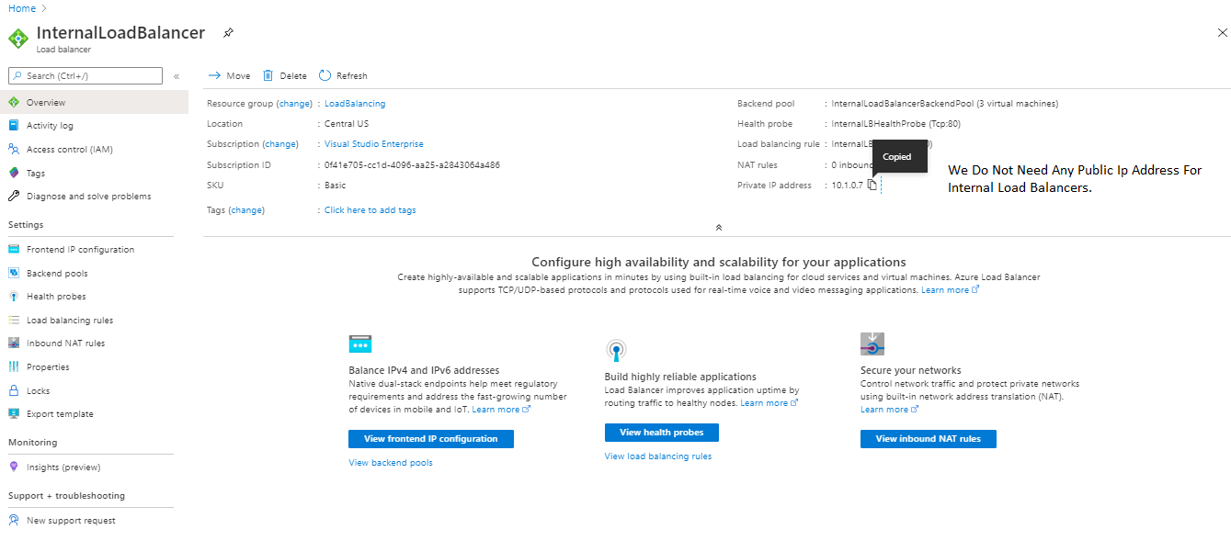

Slide 30
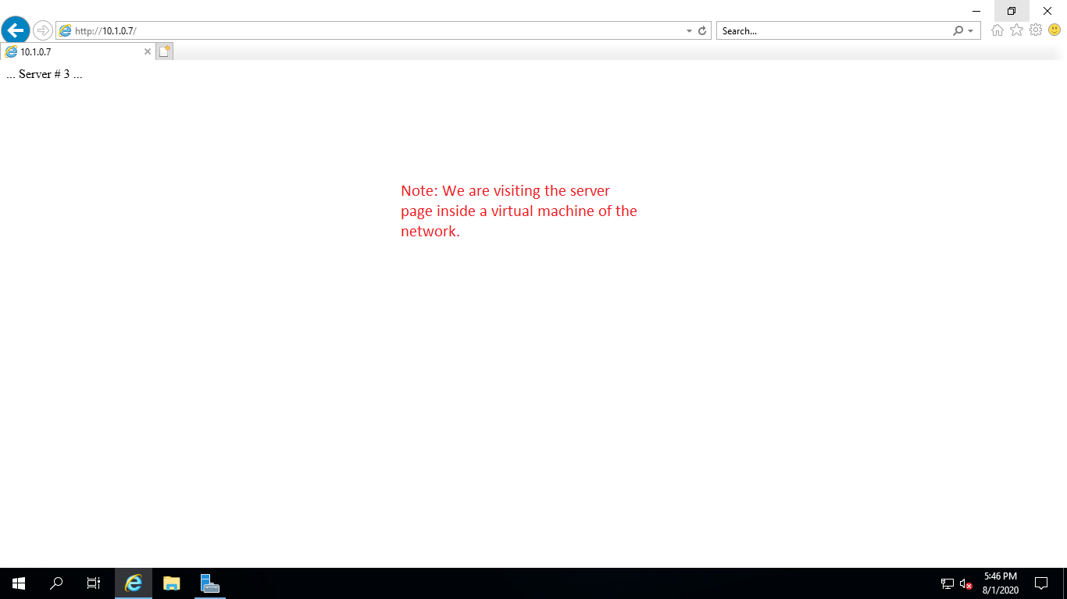
This is one of 3 virtual machines that we have created earlier.

Slide 31
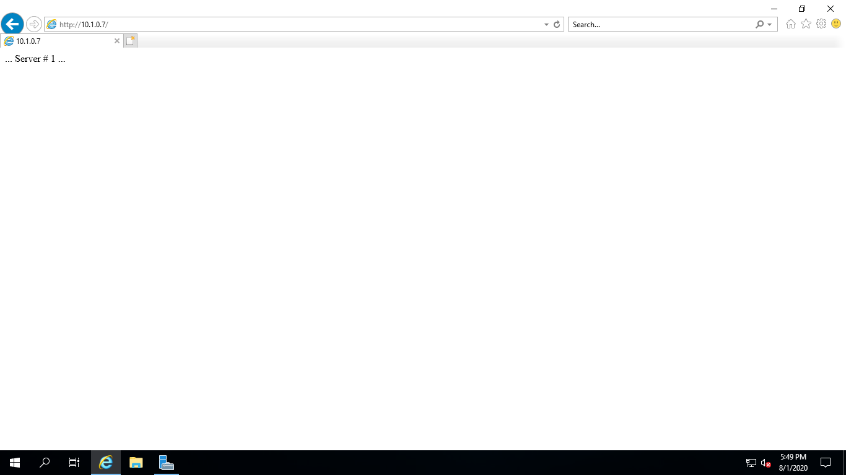
After 4 minutes of idle time, the new requests are sent to other servers in the backend pool of load balancer.

Slide 32
Creation Of A Public Zone-Redundant Load Balancer.

Slide 33
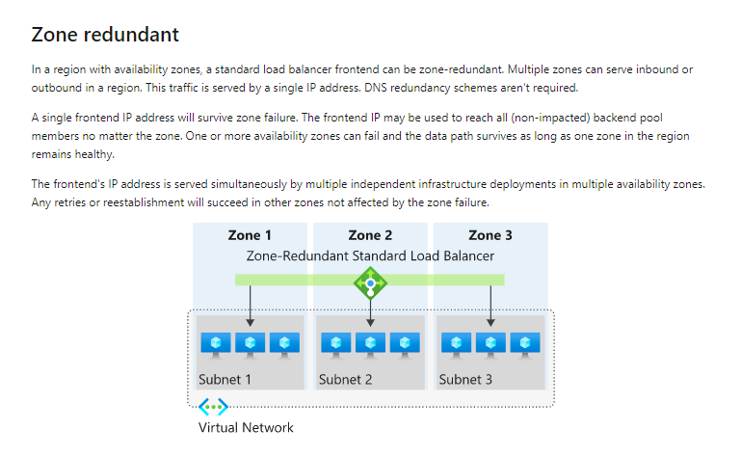

Slide 34
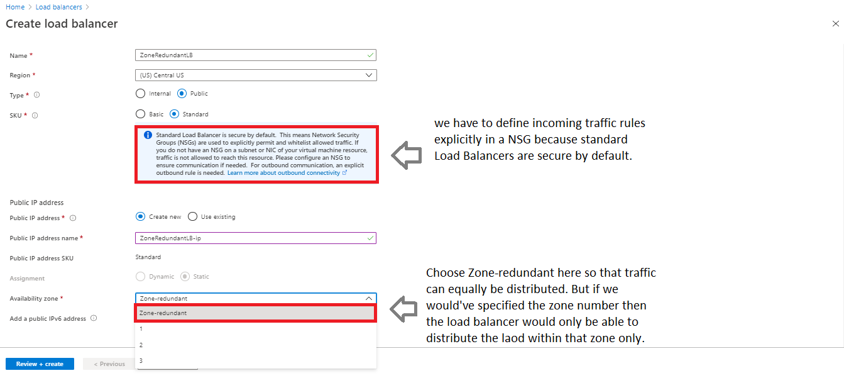

Slide 35
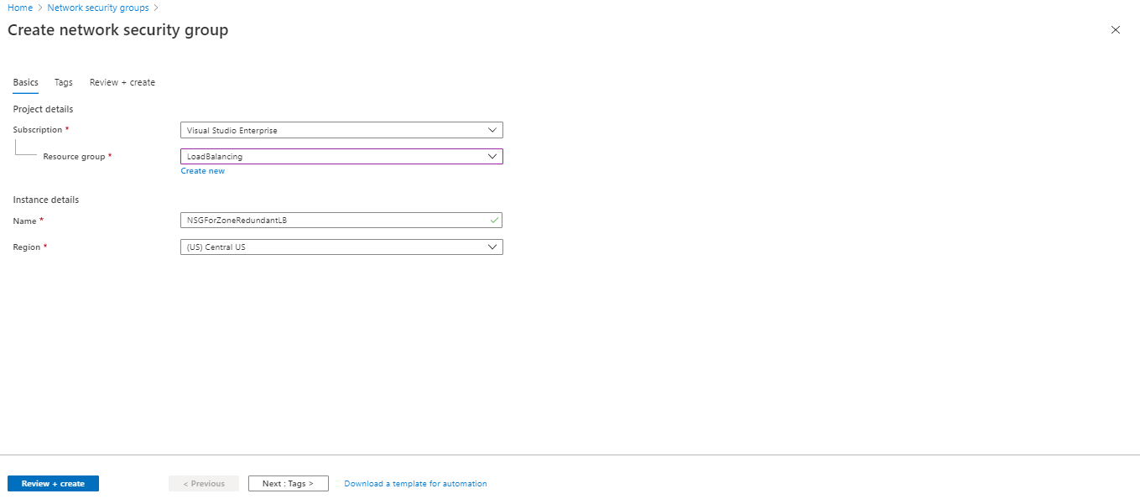

Slide 36
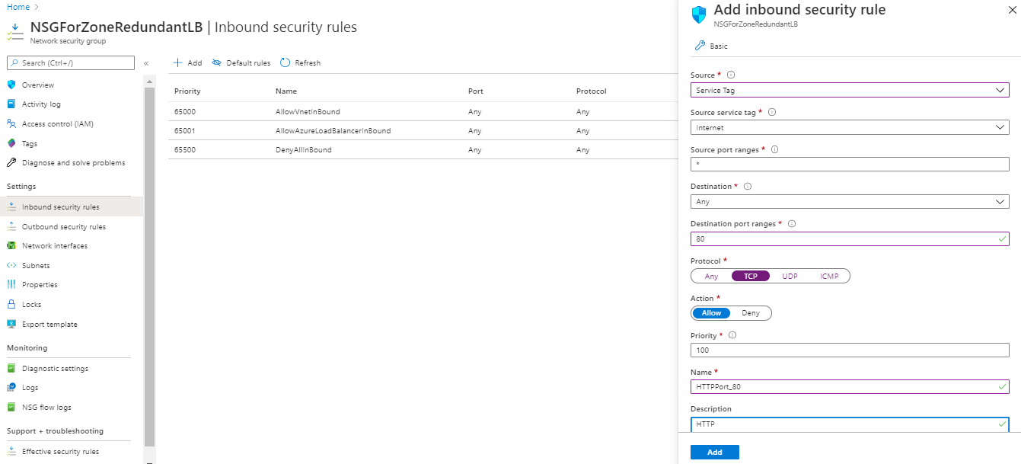
Adding inbound security rule for HTTP port 80 in NSG.

Slide 37
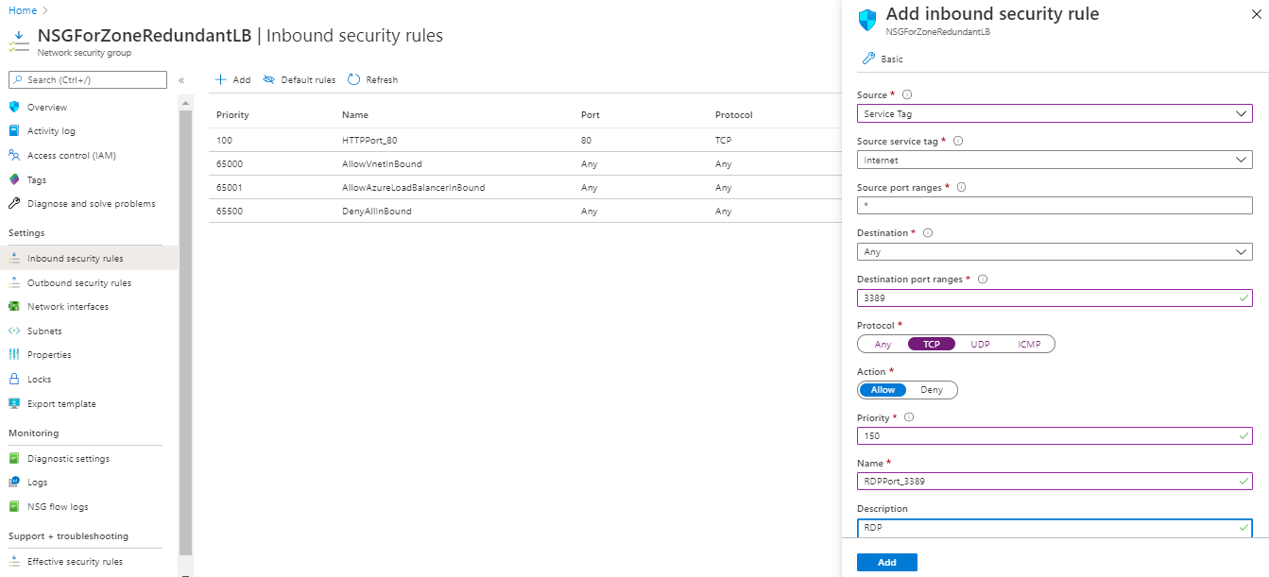
Adding inbound security rule for RDP port 3389 in NSG.

Slide 38
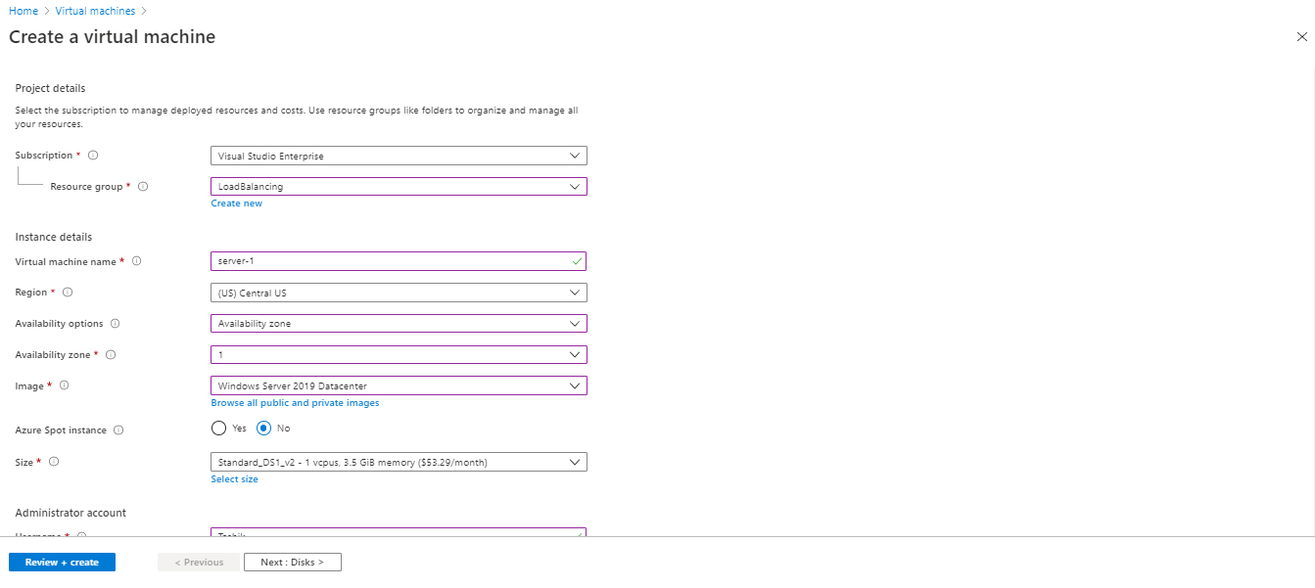
Note: Region will still be same for all the virtual machines but all the virtual machines are equally distributed in 3 zones of any region supported by Microsoft Azure.

Slide 39
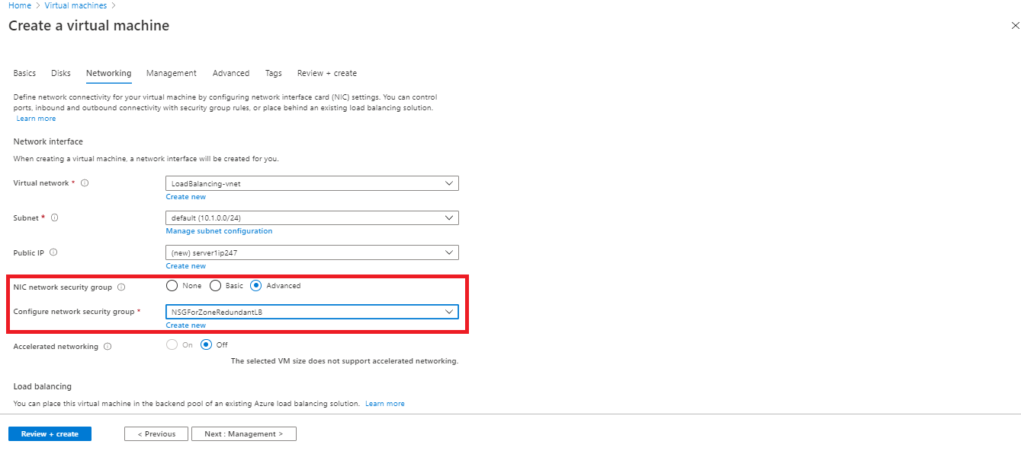
Select advanced NIC security group and choose the security group that you have made earlier.

Slide 40
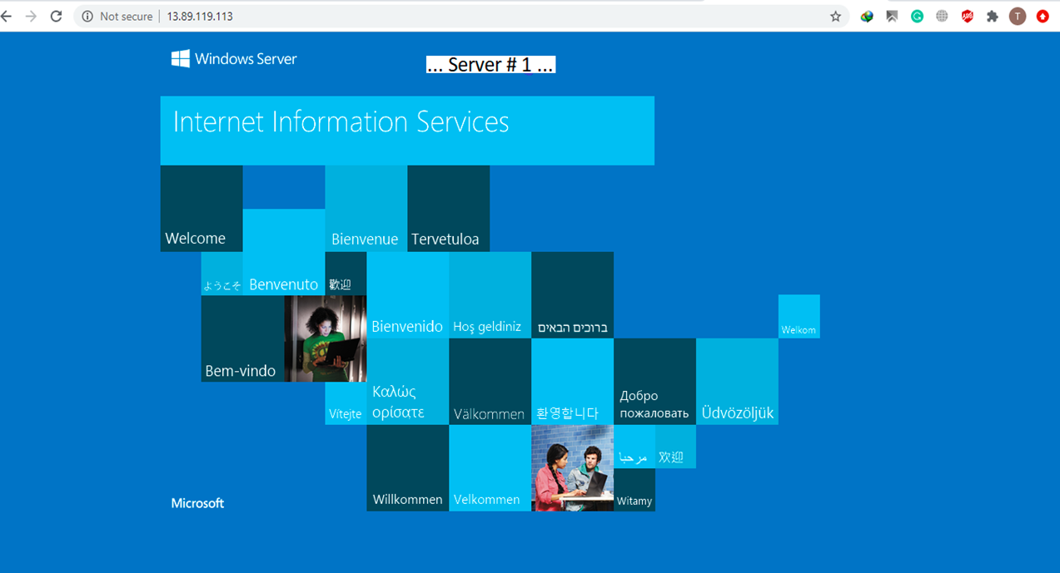

Slide 41
